Slide 1

DPC4 Results, Awards, and Closing Remarks
Co-located with HPCA 2026
Organizers: Rahul Bera, Konstantinos Kanellopoulos, and Onur Mutlu
February 1, 2026
Sydney, Australia

Slide 2
Workloads: 610 Single-Core Traces

Slide 3
Workloads: 484 Random Four-Core Trace Mixes

Slide 4
Baseline
Berti @ L1D and Pythia at L2
+15.1% in 4800 MTPS and +6.1% in 800 MTPS over no-prefetching
Why? Highest performing combination across the board
L1D: aggressive stride, IPCP, Berti
L2: VA-AMPM, SPP, SMS, Pythia
Configurations: single-core with 4800 MTPS and 800 MTPS

Slide 5
Scoring Rubric
Every submission is evaluated in three system configurations to receive three scores:
FullBW score: Non-weighted geomean speedup across 610 traces in single-core with 4800 MT/s DRAM bandwidth
LimitBW score: Non-weighted geomean speedup across 610 traces in single-core with 800 MT/s DRAM bandwidth
MC score: Non-weight geomean of harmonic speedup ratio across 484 random four-core mixes in four-core system with 4800 MT/s DRAM bandwidth
Overall score: non-weighted geomean of FullBW score, LimitBW score, and MC score

Slide 6
Scoring Rubric
Every submission is evaluated in three system configurations to receive three scores:
FullBW score: Non-weighted geomean speedup across 610 traces in single-core with 4800 MT/s DRAM bandwidth
LimitBW score: Non-weighted geomean speedup across 610 traces in single-core with 800 MT/s DRAM bandwidth
MC score: Non-weight geomean of harmonic speedup ratio across 484 random four-core mixes in four-core system with 4800 MT/s DRAM bandwidth
Overall score: non-weighted geomean of FullBW score, LimitBW score, and MC score
Winners are selected based on the overall score

Slide 7
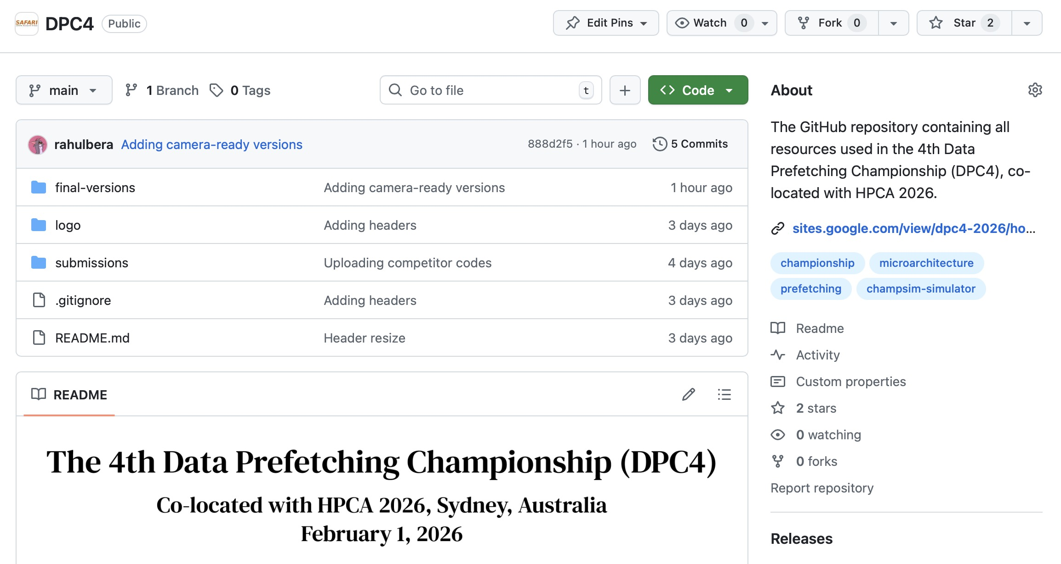
One Stop for DPC4 Resources
https://github.com/CMU-SAFARI/DPC4

Slide 8

Surprise Announcement
Monetary award for the winners!
1st Place: $2000
2nd Place: $1500
3rd Place: $1000

Slide 9

And the Winners Are ...

Slide 10
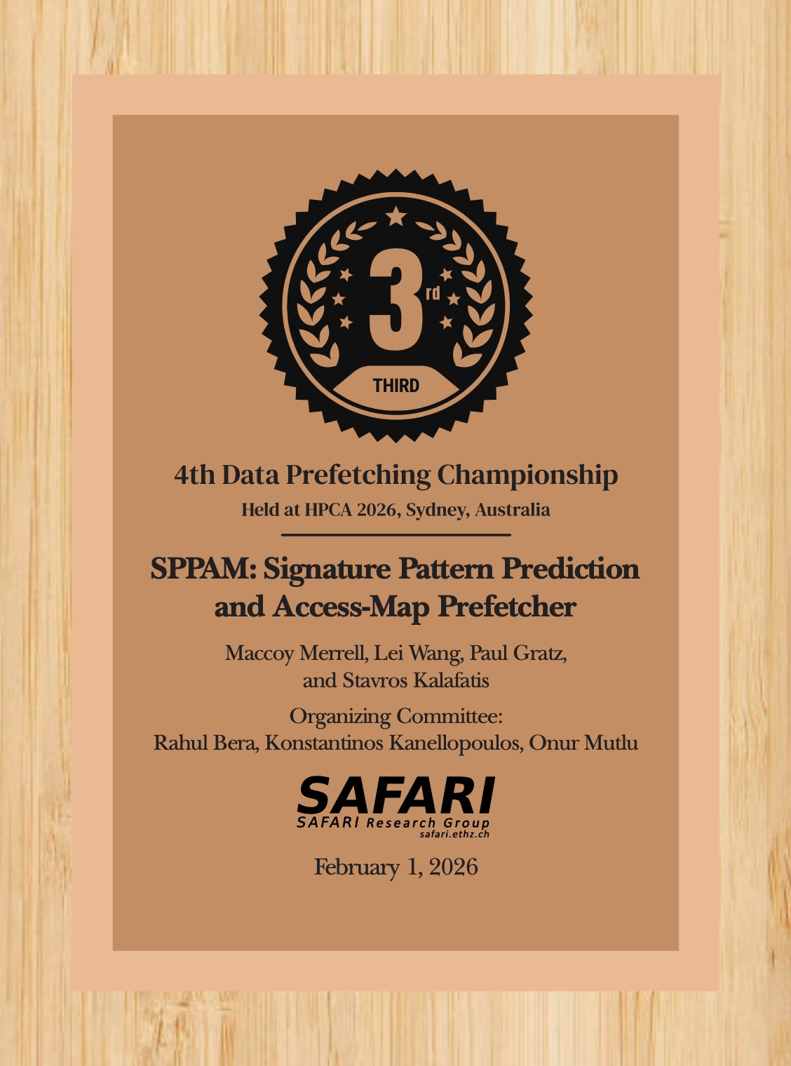


Joint 3rd Place - I
“SPPAM: Signature Pattern Prediction and Access-Map Prefetcher”
Maccoy Merrell, Lei Wang, Paul Gratz, and Savros Kalafatis
Texas A&M University

Slide 11
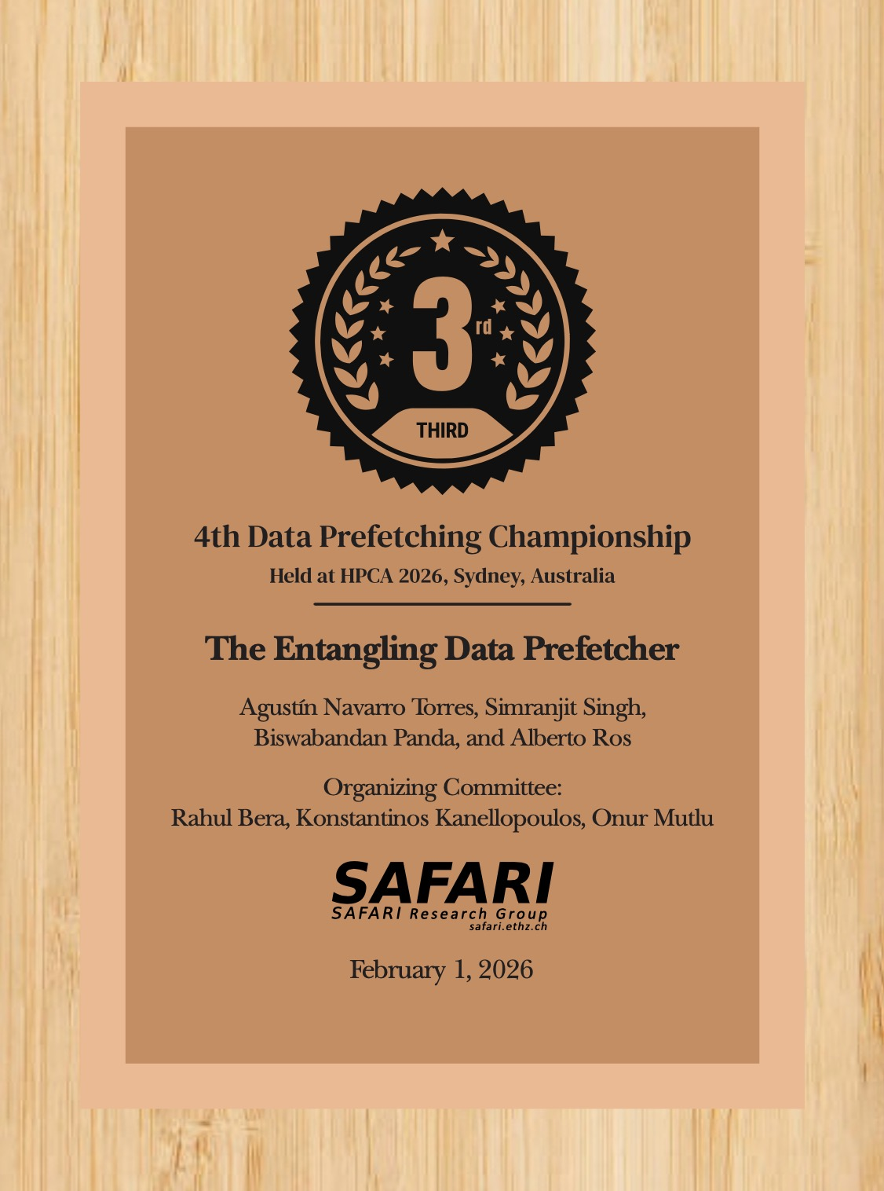

Joint 3rd Place - II
“The Entangling Data Prefetcher”
Agustin Navarro Torres, Simranjit Singh, Biswabandan Panda, and Alberto Ros
University of Zaragoza, IIT Bombay, and University of Murcia

Slide 12
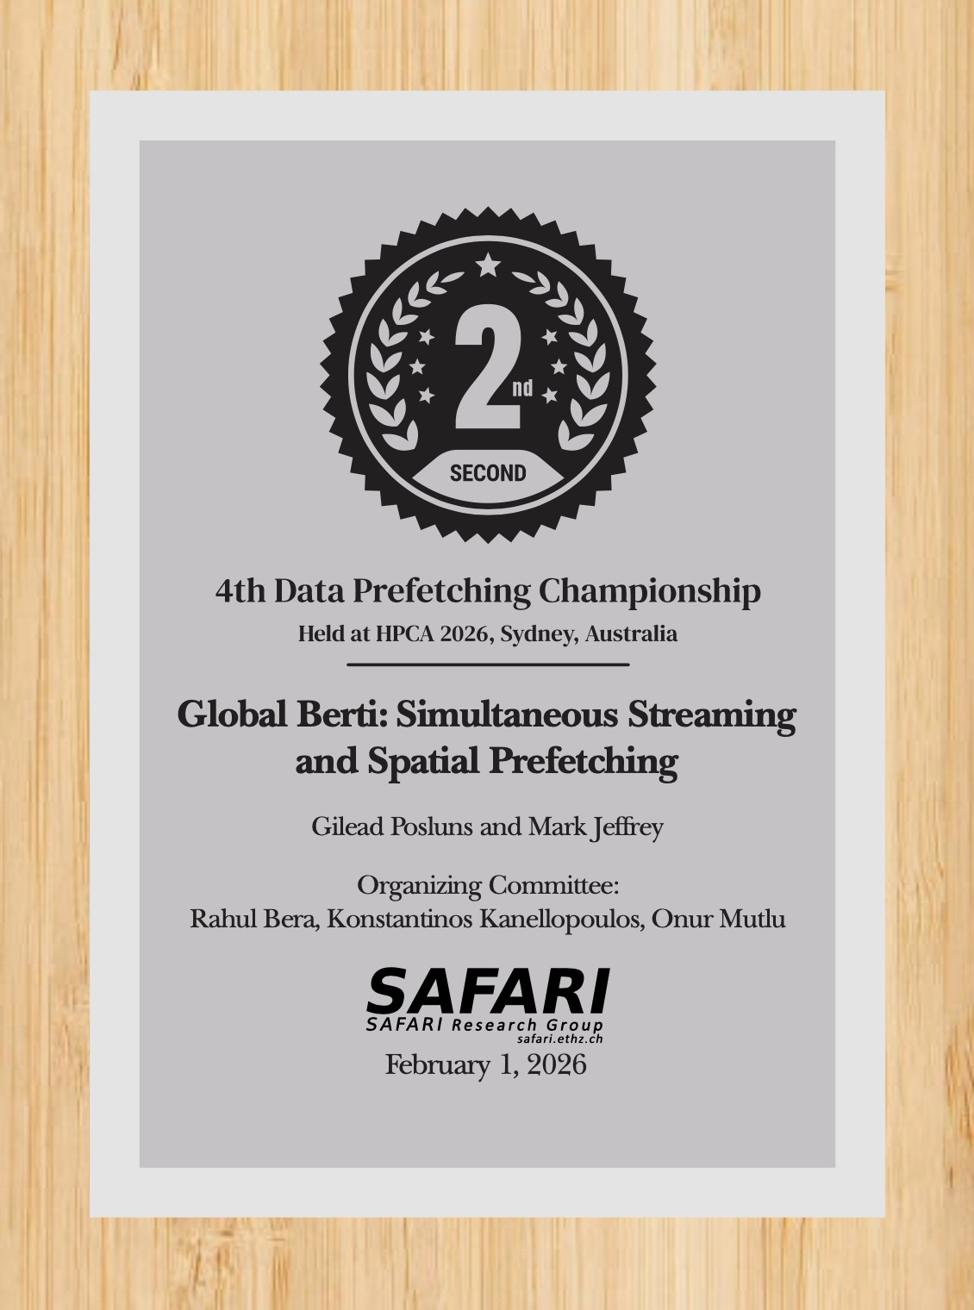

2nd Place
“Global Berti: Simultaneous Streaming and Spatial Prefetching”
Gilead Posluns and Mark Jeffrey
University of Toronto

Slide 13
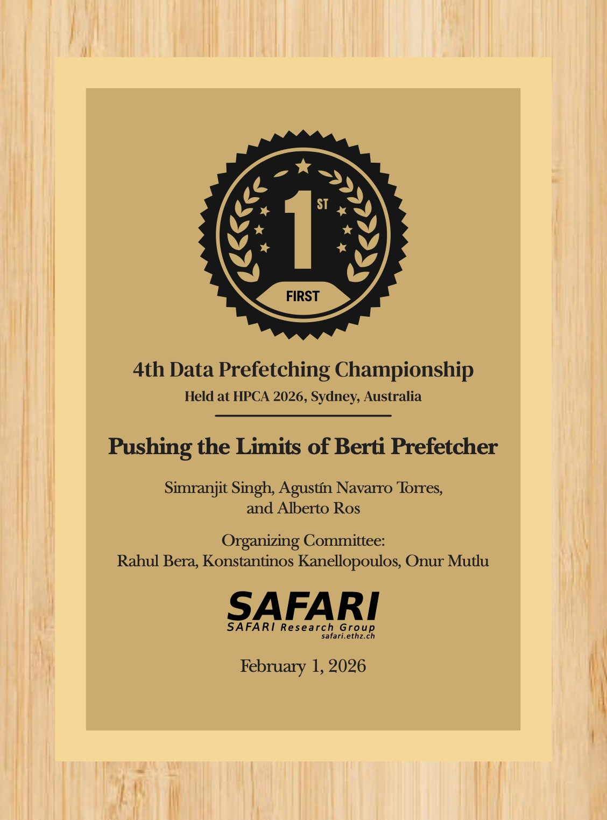

Winner of DPC4
“Pushing the Limits of Berti Prefetcher”
Simranjit Singh, Agustin Navarro Torres, and Alberto Ros
University of Murcia and University of Zaragoza

Slide 14
Results – Legend
Abbreviation | Paper
VIP | Crossing the Boundary: Virtual-Address Based Inter-Page Prefetching for Lower Level Caches
SPPAM | SPPAM: Signature Pattern Prediction and Access-Map Prefetcher
Emender | Emender: Optimizing Prefetch Priority and Throttling in VBerti+Pythia
sBerti | sBerti: Enhancing Berti with a Smart Stride Prefetcher for Better Coverage
BertiGO | Pushing the limits of the Berti prefetcher
EDP | The Entangling Data Prefetcher
uMAMA | Performance-Driven Composite Prefetching with Bandits
GBerti | Global Berti: Simultaneous Streaming and Spatial Prefetching

Slide 15
Results – Score Overview

Slide 16
Results – Score Overview

Slide 17
Results – Score Overview
BertiGO is almost consistently the best across all three scores

Slide 18
Results – Score Overview

Slide 19
Results – Score Overview
BertiGO, GBerti, and EDP are the only three submissions that outperforms the baseline in all three configurations

Slide 20
Results – Score Overview

Slide 21
Results – Score Overview
SPPAM is the only prefetcher
whose performance gain increases from FullBW to LimitBW

Slide 22
Results – FullBW Score
Most benefiting from prefetching
Least benefiting from prefetching
AIML
Google

Slide 23
Results – FullBW Score vs. DRAM Requests

Slide 24
FullBW Score per Unit Increase in DRAM Requests

Slide 25
FullBW Score per Unit Increase in DRAM Requests
Emender, SPPAM and BertiGO provide
the most performance gains for unit DRAM request overhead

Slide 26
Results – FullBW vs. LimitBW Scores
Perf. drops the most from FullBW to LimitBW

Slide 27
Results – MC Score
All prefetchers struggle
to even match the baseline

Slide 28
In Conclusion

Slide 29
Key Highlights of DPC4
8 new prefetching proposals – pushing the limits of the state-of-the-art in various system configurations
Time for community to start dissecting
482 new ChampSim traces – capturing a wide range of workloads
Hopefully be useful to posterity

Slide 30

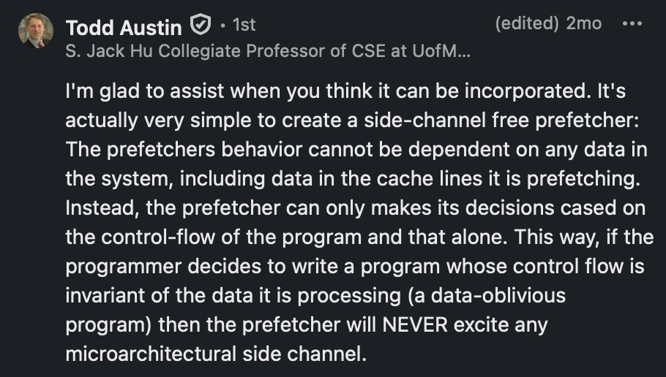
For the Next DPC ...
HW/SW co-designed prefetcher
Exposing a rich set of software-level information/hints via ChampSim API
More system-awareness, multi-core awareness, ...
Security-aware prefetcher
Any other suggestions/ideas?

Slide 31
Acknowledgements
All program committee members
Akanksha Jain
Alaa Alameldeen
Alberto Ros
Anant Nori
Biswa Panda
Leeor Peled
Mike Ferdman
Paul Gratz
Pierre Michaud
Invited speakers
Akanksha Jain
Leeor Peled
Organizers and Evaluators
Konstantinos Kanellopoulos, Onur Mutlu
Zhenrong Lang
HPCA 2026 Workshop Chair
Tom St. John
All HPCA 2026 organizers
All attendees – off-line and online

Slide 32
Thank you for attending DPC4!

Slide 33
BACKUP

Slide 34
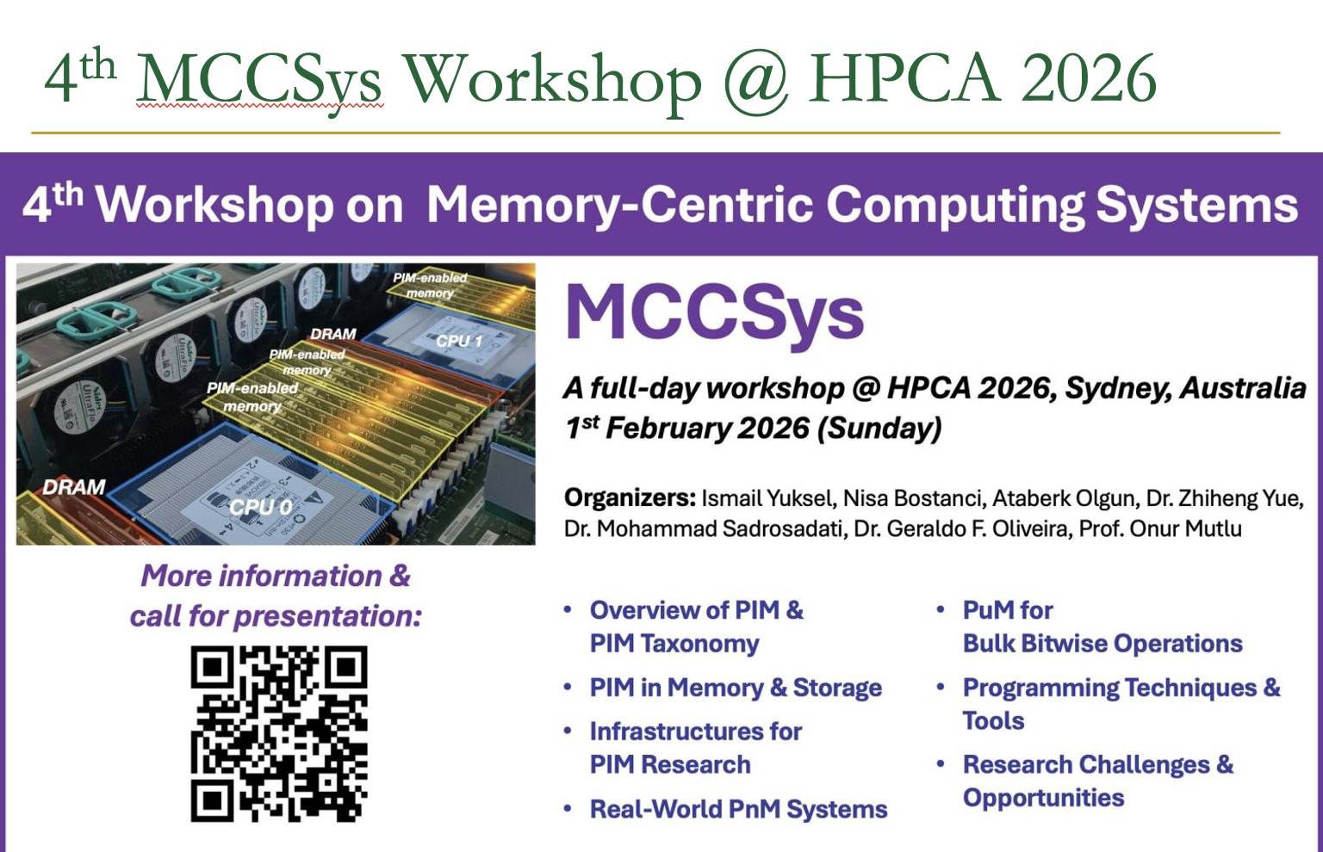
DPC4 Dinner
Venue: Alegre Bar and Dining
Time: Feb 1, 2026 8PM Sydney
Together with invited speakers from MCCSys workshop
https://events.safari.ethz.ch/hpca26-MCCSys/
https://www.youtube.com/watch?v=3wtg4sTp1qw

